Slide 1
Extracting Causal Relationship between Major Events using Wikipedia Data
Z604: Big Data Analytics for Web and Text
Mentor: Xiaozhong Liu

Slide 2
Wikipedia Group - 1
Anwar Shaikh
Jay Nagle
Prathik Rokhade
Sanjana Pukalay
Vinay Vernekar

Slide 3
Contents
Introduction (Research Question, Significance of Problem, Background Information)
Data Description
Data Indexation Method
Methodology
Experiment Result
Conclusion and limitation
Future Work

Slide 4
Introduction - Research Question
Extracting Data and understanding the Sub-Causes and Effects that lead to the Main Event - Can we tell a story?
Finding Correlation and Causal Relationships between Events that have a chain of Sub-Events
Building a Timeline of Events - What led to what?
Visual learning in a gist and forensic examination

Slide 5
Significance and Background
Helps visualize causal relationship between various events
Helps analyse the root cause of an event
Synergy of events
Break up of events into small subevents

Slide 6
Dataset Description - Wikipedia
Used Wikipedia Data Dump from Official Website
Data Size - 100GB (Uncompressed)
Structured Data - XML Format
Extremely Huge Dataset - Used a Subset of Financial Data

Slide 7
Subset Description - Financial Data
Extracted data associated with all available 41 Finance and Economy related wikipedia categories
Stored and Indexed using Lucene
Used 1130 pages for Semantic Role Labeling

Slide 8
Workflow
Event Extraction and Sentiment Annotation
Indexing and Preprocessing
Identifying entities affected
Wikipedia Data
Visualize
Feed into Neo4j
Semantic Role labelling
Connecting similar events

Slide 9




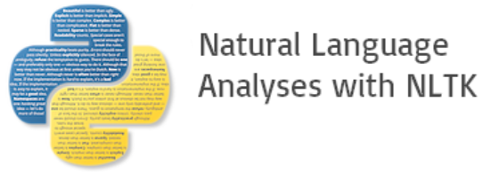


Technology Stack

Slide 10
Methodology - Data Extraction
Filtered Data related to Financial Events relevant to the Research Question
Built a Multi-Threaded Parser from scratch in Java
Input: List of Categories and Titles
Extraction Methodology: Generic Multi-Threaded Parser
Output: List of Relevant Pages

Slide 11
Methodology - Data Indexation
Created Lucene Index using English analyzer with custom stop words on extracted subset of data
Attributes stored are Page ID, Page Title and Page Text
Purpose:
Lucene allows efficient access to textual data well suited for NLP processing we wanted to do

Slide 12
Methodology - Data Preprocessing
Retaining ID, Title, Plain Text, Hyperlinks
Striping Meta Data, Tables
Storing and Indexing in Lucene

Slide 13
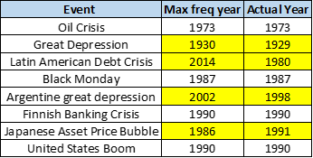
Experiment - Finding Similar Events
Year in format for YYYY

Slide 14

Experiment - Finding Similar Events
Constructed Occurrence Correlation Matrix using WUP similarity of most frequent Nouns in each page
Weighted the effect using Time Gap in Event

Slide 15
Experiment - Finding Causal Relationships
Semantic Role Labelling using NLTK, Practnlptools
Sample Input:
“The recession caused demand for energy to shrink in late 2008.“
Annotated Output:
{'A1': 'demand for energy to shrink in late 2008', 'A0': 'The recession', 'V': 'caused'}

Slide 16
Analysis
Same entities are getting affected in different time lags
Each main event has an average of ~11 sub causes and effects that lead to the man events
High Frequency Nouns are representative of the entity being affected

Slide 17
Experiment Result
Neo4j Visualization

Slide 18
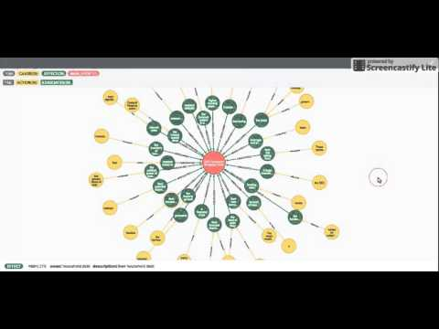

Slide 19
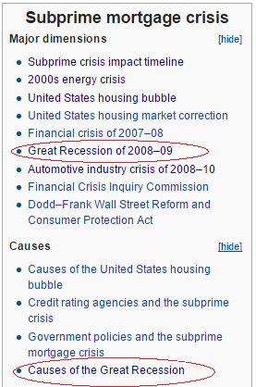
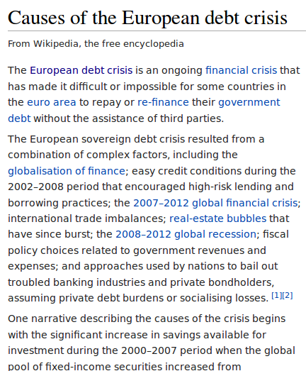
Evaluation
Evaluation Estimation Using Wiki Infobox
We have manually created ground truth for sample of events by reading wiki pages

Slide 20
Evaluation
F-Measure
Analyzed total 358 causes in results-
Label | Causes | Not Causes
Identified Causes | TP = 172 | FP = 88
Not Identified | FN = 98 | TN = NA

Slide 21
Evaluation
F-Score ~ 0.6490
Precision - 0.6615
Recall - 0.6370
Label | Causes | Not Causes
Identified Causes | TP = 172 | FP = 88
Not Identified | FN = 98 | TN = NA

Slide 22
Conclusion and Limitations
Conclusion:
Useful in representation of causal relationship between various events
Limitations:
Some noise in SRL using practnlptools
Difficult to determine the importance/rank of Individual Sub -Events

Slide 23
Future Work
Could be extended to different topics and domains
Remove noise generated by SRL algorithm
Create weighted/ranked results and use MAP or NDCG evaluation
Possibly we can create a Bayesian network

Slide 24
Thank You!
Questions?

